Slide 1
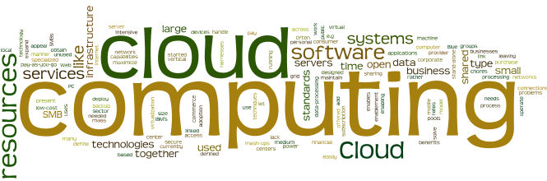
Cloud Computing Essentials and Actors

Slide 2
Module Objectives
You should able to answer below questions end of this module.
Notes:
Virtualization is an evolving technology in the IT world. Virtualization is being used by a growing number of organizations to consolidate their workloads, to make their IT environments scalable and more flexible.

Slide 3

Cloud Service models in AWS
IaaS
(infrastructure as a service)
PaaS
(platform as a service)
SaaS
(software as a service)
More control over IT resources
Less control over IT resources
Notes:
There are three main cloud service models. Each model represents a different part of the cloud computing stack and gives you a different level of control over your IT resources:
Infrastructure as a service (IaaS): Services in this category are the basic building blocks for cloud IT and typically provide you with access to networking features, computers (virtual or on dedicated hardware), and data storage space. IaaS provides you with the highest level of flexibility and management control over your IT resources. It is the most similar to existing IT resources that many IT departments and developers are familiar with today.
Platform as a service (PaaS): Services in this category reduce the need for you to manage the underlying infrastructure (usually hardware and operating systems) and enable you to focus on the deployment and management of your applications.
Software as a service (SaaS): Services in this category provide you with a completed product that the service provider runs and manages. In most cases, software as a service refers to end-user applications. With a SaaS offering, you do not have to think about how the service is maintained or how the underlying infrastructure is managed. You need to think only about how you plan to use that particular piece of software. A common example of a SaaS application is web-based email, where you can send and receive email without managing feature additions to the email product or maintaining the servers and operating systems that the email program runs on.

Slide 4
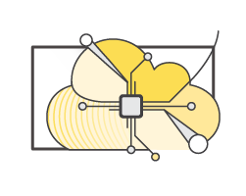
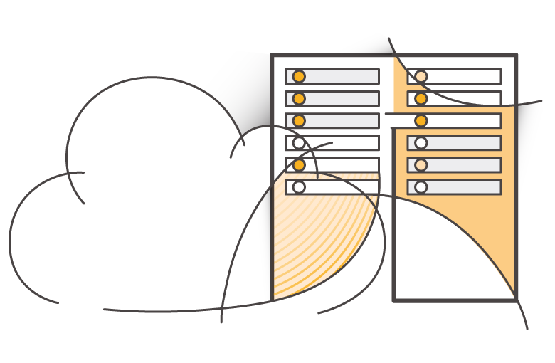
Cloud computing deployment models
Cloud
Hybrid
On-premises (private cloud)
Notes:
There are three main cloud computing deployment models, which represent the cloud environments that your applications can be deployed in:
Cloud: A cloud-based application is fully deployed in the cloud, and all parts of the application run in the cloud. Applications in the cloud have either been created in the cloud or have been migrated from an existing infrastructure to take advantage of the benefits of cloud computing. Cloud-based applications can be built on low-level infrastructure pieces or they can use higher-level services that provide abstraction from the management, architecting, and scaling requirements of core infrastructure.
Hybrid: A hybrid deployment is a way to connect infrastructure and applications between cloud-based resources and existing resources that are not located in the cloud. The most common method of hybrid deployment is between the cloud and existing on-premises infrastructure. This model enables an organization to extend and grow their infrastructure into the cloud while connecting cloud resources to internal systems.
On-premises: Deploying resources on-premises, using virtualization and resource management tools, is sometimes called private cloud. While on-premises deployment does not provide many of the benefits of cloud computing, it is sometimes sought for its ability to provide dedicated resources. In most cases, this deployment model is the same as legacy IT infrastructure, but it might also use application management and virtualization technologies to increase resource utilization.

Slide 5

















Similarities between AWS and traditional IT
Traditional, on-premises IT space
AWS
Security
Security groups
Firewalls
ACLs
Administrators
Network ACLs
IAM
Networking
Router
Network pipeline
Switch
Elastic Load Balancing
Amazon VPC
On-premises servers
Compute
AMI
Amazon EC2 instances
Storage and database
DAS
SAN
NAS
RDBMS
Amazon EBS
Amazon EFS
Amazon S3
Amazon RDS
Notes:
There are many similarities between AWS and the traditional, on-premises IT space:
AWS security groups, network access control lists (network ACLs), and AWS Identity and Access Management (IAM) are similar to firewalls, access control lists (ACLs), and administrators.
Elastic Load Balancing and Amazon Virtual Private Cloud (Amazon VPC) are similar to routers, network pipelines, and switches.
Amazon Machine Images (AMIs) and Amazon Elastic Compute Cloud (Amazon EC2) instances are similar to on-premises servers.
Amazon Elastic Block Store (Amazon EBS), Amazon Elastic File System (Amazon EFS), Amazon Simple Storage Service (Amazon S3), and Amazon Relational Database Service (Amazon RDS) are similar to direct attached storage (DAS), storage area networks (SAN), network attached storage (NAS), and a relational database management service (RDBMS).
With AWS services and features, you can do almost everything that you would want to do with a traditional data center.

Slide 6
Advantages of Cloud Computing
1. Trade capital expense for variable expense
2. Benefit from massive economies of scale
3. Stop guessing about capacity
4. Increase speed and agility
5. Stop spending money running and maintaining data centers
6. Go global in minutes

Slide 7



What are web services?
A web service is any piece of software that makes itself available over the internet and uses a standardized format—such as Extensible Markup Language (XML) or JavaScript Object Notation (JSON)—for the request and the response of an application programming interface (API) interaction.
Request message
Internet
Response message
Client
Web service
Notes:
In general, a web service is any piece of software that makes itself available over the internet or on private (intranet) networks. A web service uses a standardized format—such as Extensible Markup Language (XML) or JavaScript Object Notation (JSON)—for the request and the response of an application programming interface (API) interaction. It is not tied to any one operating system or programming language. It’s self-describing via an interface definition file and it is discoverable.

Slide 8
What is AWS?
AWS is a secure cloud platform that offers a broad set of global cloud-based products.
AWS provides you with on-demand access to compute, storage, network, database, and other IT resources and management tools.
AWS offers flexibility.
You pay only for the individual services you need, for as long as you use them.
AWS services work together like building blocks.
Notes:
Amazon Web Services (AWS) is a secure cloud platform that offers a broad set of global cloud-based products. Because these products are delivered over the internet, you have on-demand access to the compute, storage, network, database, and other IT resources that you might need for your projects—and the tools to manage them. You can immediately provision and launch AWS resources. The resources are ready for you to use in minutes.
AWS offers flexibility. Your AWS environment can be reconfigured and updated on demand, scaled up or down automatically to meet usage patterns and optimize spending, or shut down temporarily or permanently. The billing for AWS services becomes an operational expense instead of a capital expense.
AWS services are designed to work together to support virtually any type of application or workload. Think of these services like building blocks, which you can assemble quickly to build sophisticated, scalable solutions, and then adjust them as your needs change.

Slide 9



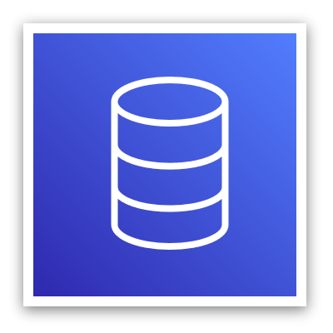

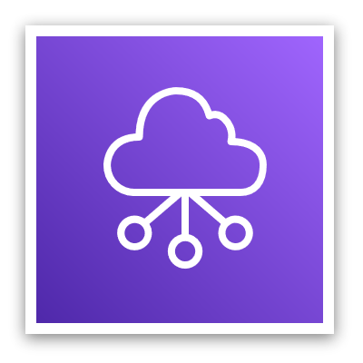

Services covered in this course
Compute services –
Amazon EC2
AWS Lambda
AWS Elastic Beanstalk
Amazon EC2 Auto Scaling
Amazon ECS
Amazon EKS
Amazon ECR
AWS Fargate
Storage services –
Amazon S3
Amazon S3 Glacier
Amazon EFS
Amazon EBS
Management and Governance services –
AWS Trusted Advisor
AWS CloudWatch
AWS CloudTrail
AWS Well-Architected Tool
AWS Auto Scaling
AWS Command Line Interface
AWS Config
AWS Management Console
AWS Organizations
Database services –
Amazon RDS
Amazon DynamoDB
Amazon Redshift
Amazon Aurora
Security, Identity, and Compliance services –
AWS IAM
Amazon Cognito
AWS Shield
AWS Artifact
AWS KMS
Networking and Content Delivery services –
Amazon VPC
Amazon Route 53
Amazon CloudFront
Elastic Load Balancing
AWS Cost Management services –
AWS Cost & Usage Report
AWS Budgets
AWS Cost Explorer
Notes:
The array of AWS services can be intimidating as you start your journey into the cloud. This course focuses on some of the more common services in the following service categories: compute, storage, database, networking and content delivery, security, identity, and compliance, management and governance, and AWS cost management.
Legend:
Amazon Elastic Block Store (Amazon EBS)
Amazon Elastic Compute Cloud (Amazon EC2)
Amazon Elastic Container Registry (Amazon ECR)
Amazon Elastic Container Service (Amazon ECS)
Amazon Elastic File System (Amazon EFS)
Amazon Elastic Kubernetes Service (Amazon EKS)
Amazon Relational Database Service (Amazon RDS)
Amazon Simple Storage Service (Amazon S3)
Amazon Virtual Private Cloud (Amazon VPC)
AWS Identity and Access Management (IAM)
AWS Key Management Service (AWS KMS)

Slide 10





Simple solution example
Networking
Compute
Database
Storage
AWS Cloud
Virtual Private Cloud (VPC)
Amazon DynamoDB
Users
Amazon S3
Amazon EC2
Notes:
For example, say you’re building a database application. Your customers might be sending data to your Amazon Elastic Compute Cloud (Amazon EC2) instances, which is a service in the compute category. These EC2 servers batch the data in one-minute increments and add an object per customer to Amazon Simple Storage Service (Amazon S3), the AWS storage service you’ve chosen to use. You can then use a nonrelational database like Amazon DynamoDB to power your application, for example, to build an index so that you can find all the objects for a given customer that were collected over a certain period. You might decide to run these services inside an Amazon Virtual Private Cloud (Amazon VPC), which is a service in the networking category.
The purpose of this simple example is to illustrate that you can select web services from different categories and use them together to build a solution (in this case, a database application). Of course, the solutions you build can be quite complex.

Slide 11

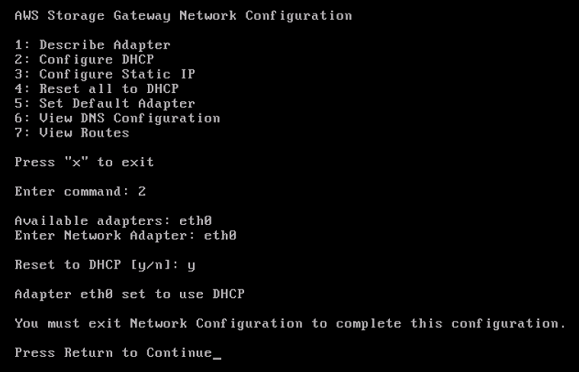
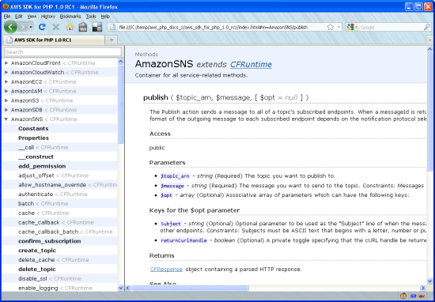
Three ways to interact with AWS
AWS Management Console
Easy-to-use graphical interface
Command Line Interface (AWS CLI)
Access to services by discrete commands or scripts
Software Development Kits (SDKs)
Access services directly from your code (such as Java, Python, and others)
Notes:
You might wonder how to access the broad array of services that are offered by AWS. There are three ways to create and manage resources on the AWS Cloud:
AWS Management Console: The console provides a rich graphical interface to a majority of the features offered by AWS. (Note: From time to time, new features might not have all of their capabilities included in the console when the feature initially launches.)
AWS Command Line Interface (AWS CLI): The AWS CLI provides a suite of utilities that can be launched from a command script in Linux, macOS, or Microsoft Windows.
Software development kits (SDKs): AWS provides packages that enable accessing AWS in a variety of popular programming languages. This makes it easy to use AWS in your existing applications and it also enables you to create applications that deploy and monitor complex systems entirely through code.
All three options are built on a common REST-like API that serves as the foundation of AWS.
To learn more about tools you can use to develop and manage applications on AWS, see Tools to Build on AWS.

Slide 12
Sample exam question
Why is AWS more economical than traditional data centers for applications with varying compute workloads?
Amazon Elastic Compute Cloud (Amazon EC2) costs are billed on a monthly basis.
Customers retain full administrative access to their Amazon EC2 instances.
Amazon EC2 instances can be launched on-demand when needed.
Customers can permanently run enough instances to handle peak workloads.

Slide 13
Did you learn ?
In summary, in this module you learned how to:
Define different types of cloud computing models
Describe six advantages of cloud computing
Recognize the main AWS service categories and core services
Review the AWS Cloud Adoption Framework
Notes:
In summary, in this module you learned how to:
Define different types of cloud computing
Describe six advantages of cloud computing
Recognize the main AWS service categories and core services
Reviewed the AWS Cloud Adoption Framework
To finish this module, complete the knowledge check.

Slide 14
Module Summary
In summary, in this module you learned how to:
Define different types of cloud computing models
Describe six advantages of cloud computing
Recognize the main AWS service categories and core services
Review the AWS Cloud Adoption Framework

